Slide 1
VISUALIZATION ON SALES INSIGHT
PRESENTED BY -
RITIK SHARMA(211FJ01050)

Slide 2
VISUALIZATION ON SALES INSIGHT
Sales Insight-
It is the understanding of a specific cause and effect within a particular context. The term insight can have
several related meanings:
A piece of information
The act or result of understanding the inner nature of things .

Slide 3
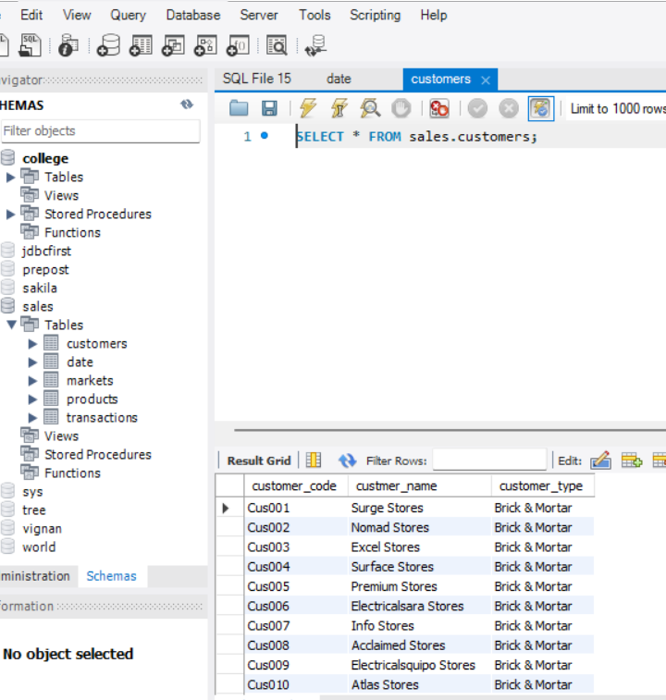
VISUALIZATION ON SALES INSIGHT
Suppose we are having a big company so we are not provides our all product to all people directly.
because it is very difficult , so with the help of general store persons we can provides it .
store persons are limited so it is easy to provide then all products and also we are provide them some specific id which define them
Here I am enclouding all details about of customer in special table called customers

Slide 4
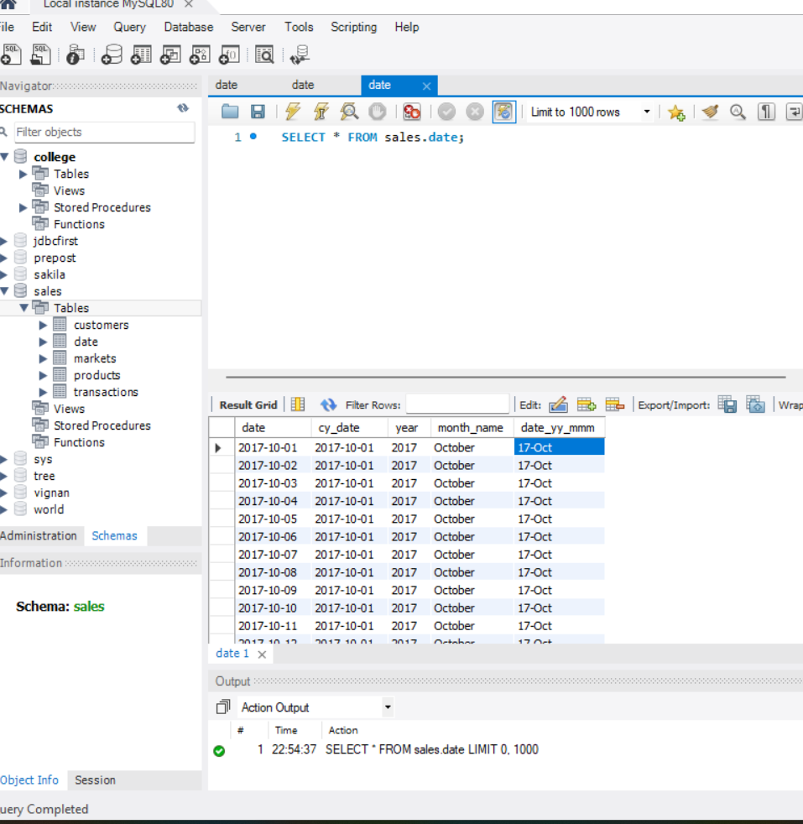
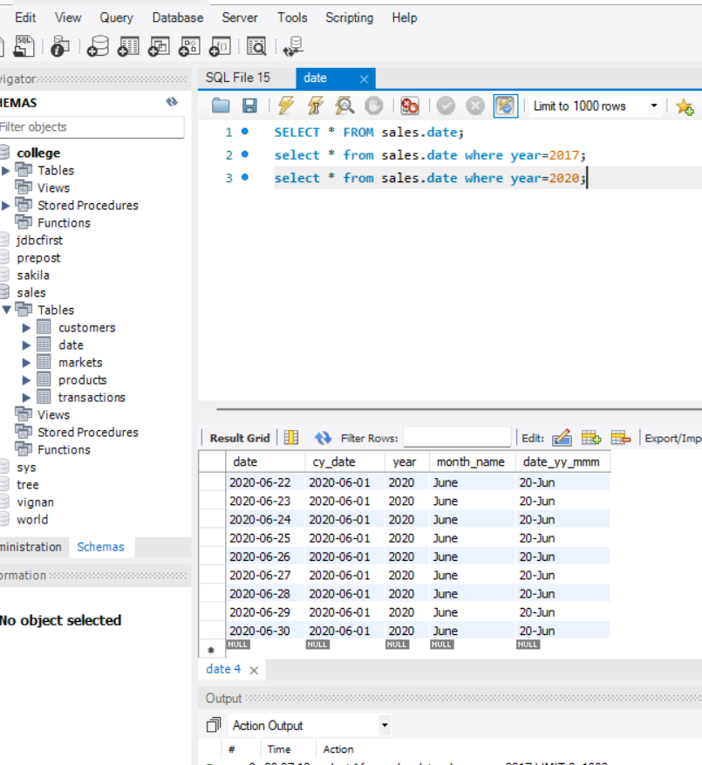
VISUALIZATION ON SALES INSIGHT
start
end
We want to understandings or analyse of your all product according to their years and months
So I taking data of our product from June2017 to June2020

Slide 5
VISUALIZATION ON SALES INSIGHT
To do this project I have created five tables
Customers table
Date
Markets
Products
transactions

Slide 6
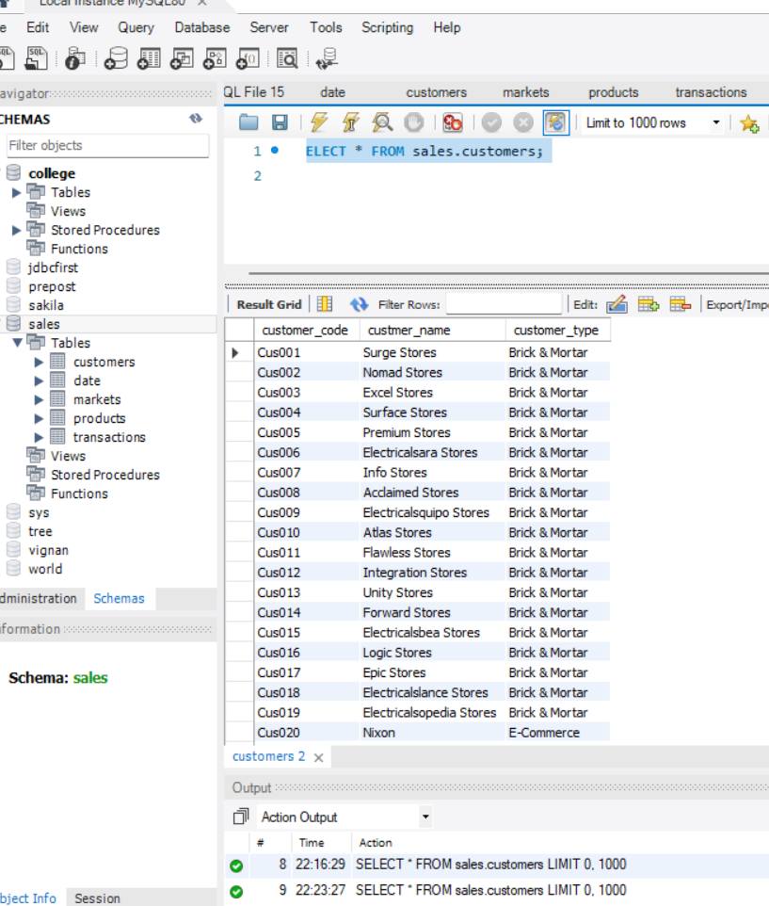
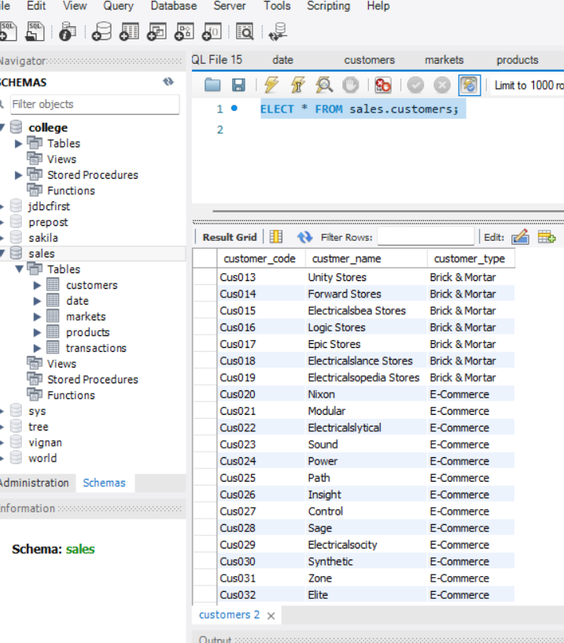
VISUALIZATION ON SALES INSIGHT
Customers table
A customer table is having all information about customer like– customer name
Customer code
Customer type

Slide 7
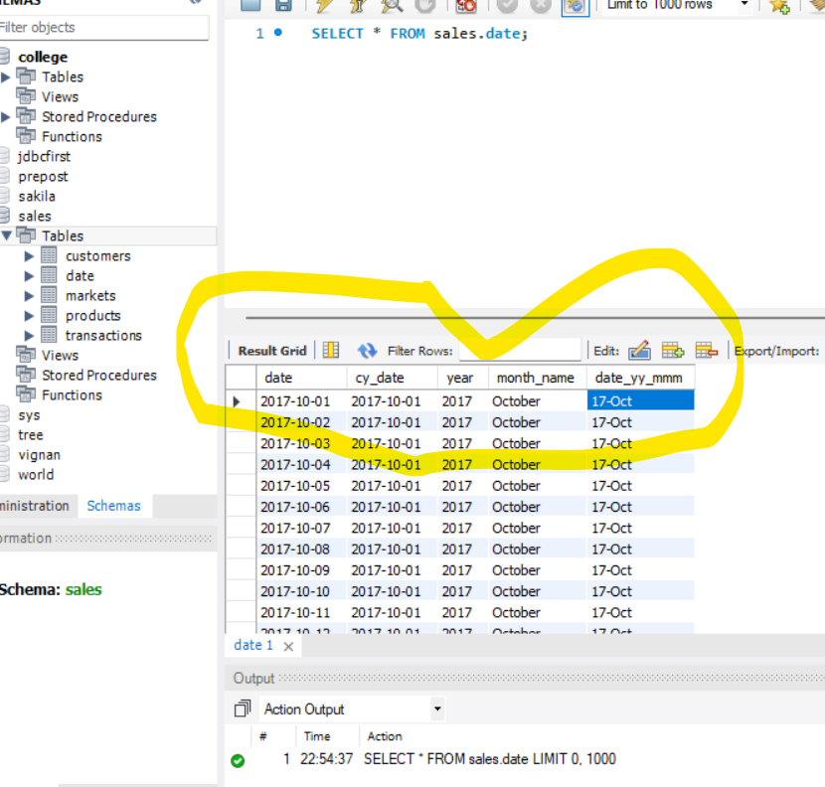
VISUALIZATION ON SALES INSIGHT
Date table
In the date table we having five collumn
Year
Month_name
Cy_date
Date
Date_yy_mmm

Slide 8
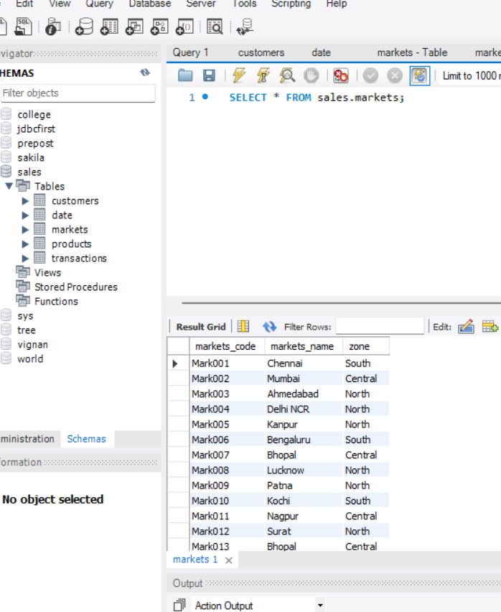
VISUALIZATION ON SALES INSIGHT
Markets– having three column
market code
Market name
zone

Slide 9
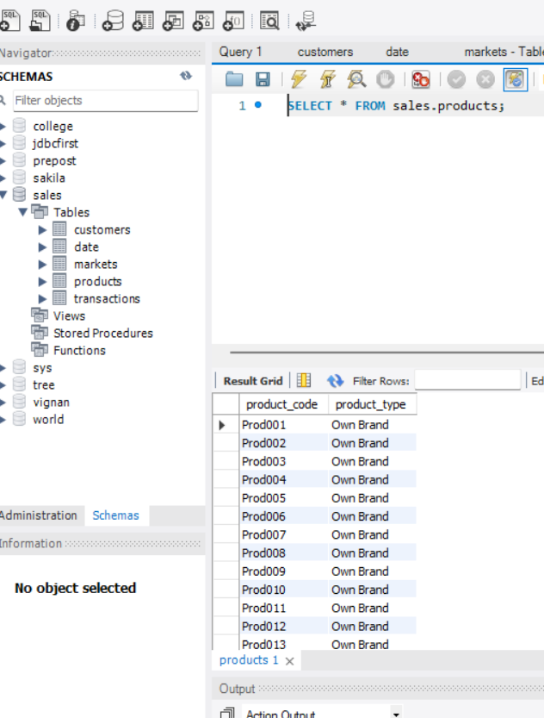
VISUALIZATION ON SALES INSIGHT
Products--- having two column
product code
Product type

Slide 10
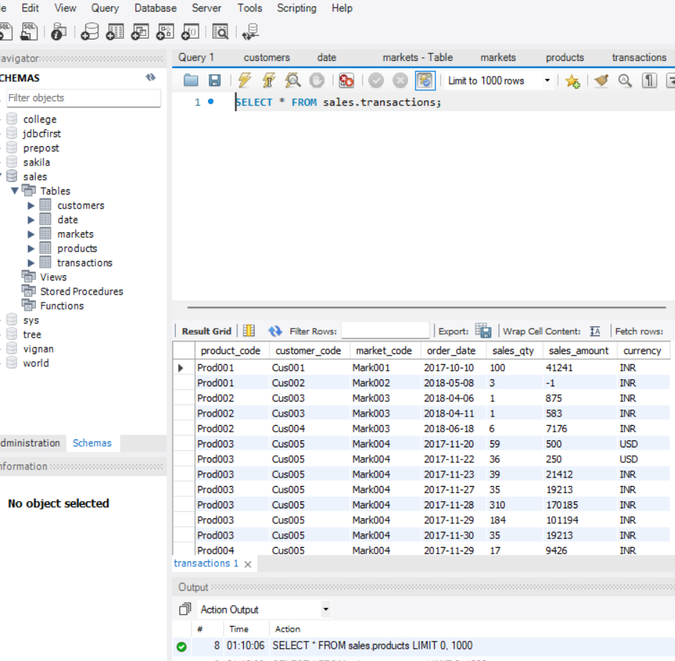
VISUALIZATION ON SALES INSIGHT
Transactions– having seven column .
Product code
Customer code
Market code
Order date
Sales qty
Sales amount
currency

Slide 11
VISUALIZATION ON SALES INSIGHT
AIM–
TO VISUALIZE TOP FIVE PRODUCT PERFORMANCE.
TO VISUALIZE TOP FIVE CUSTOMERS.
TO VISUALIZE SALES QUANTITY BY MARKET.
TO VISUALIZE REVENUE BY MARKETS.
TO VISUALIZE SALES PERFORMANCE BY YEARS.
TO VISUALIZE SALES PERFORMANCE BY MONTHS.

Slide 12
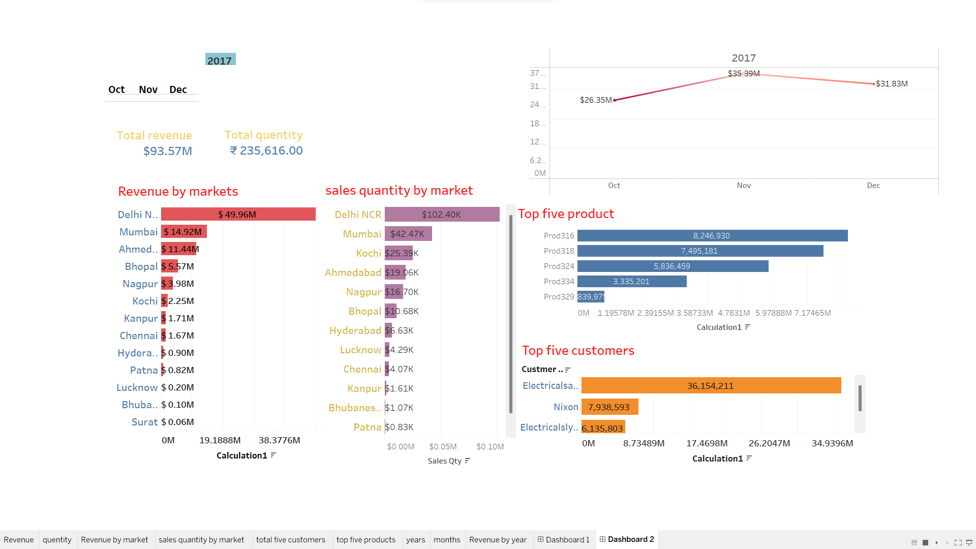
VISUALIZATION ON SALES INSIGHT BY 2017

Slide 13
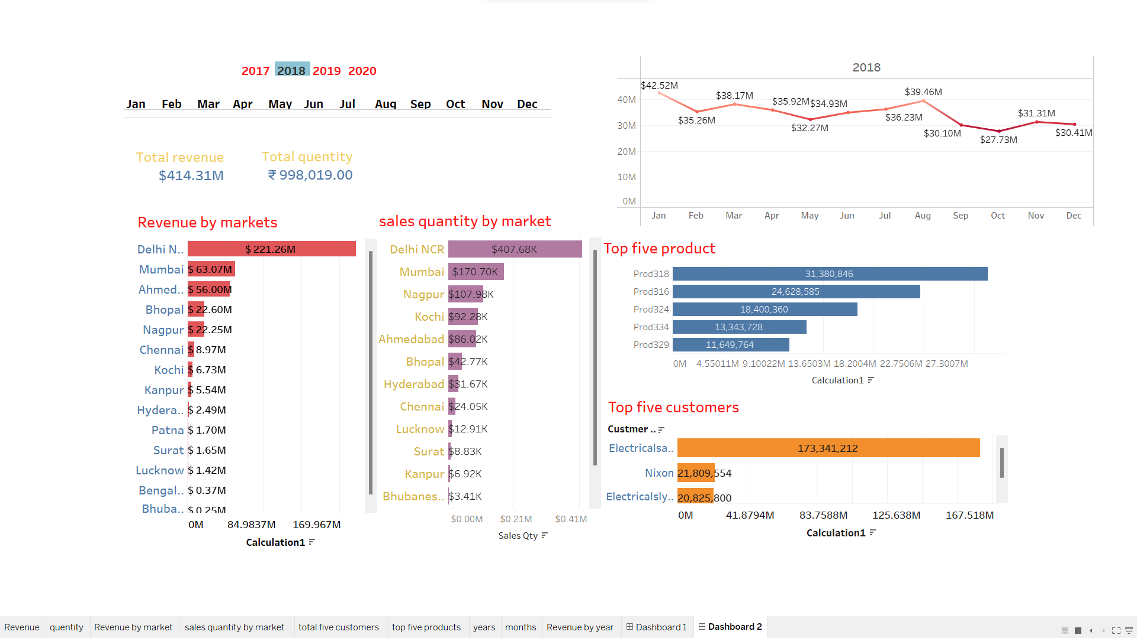
VISUALIZATION ON SALES INSIGHT BY 2018

Slide 14
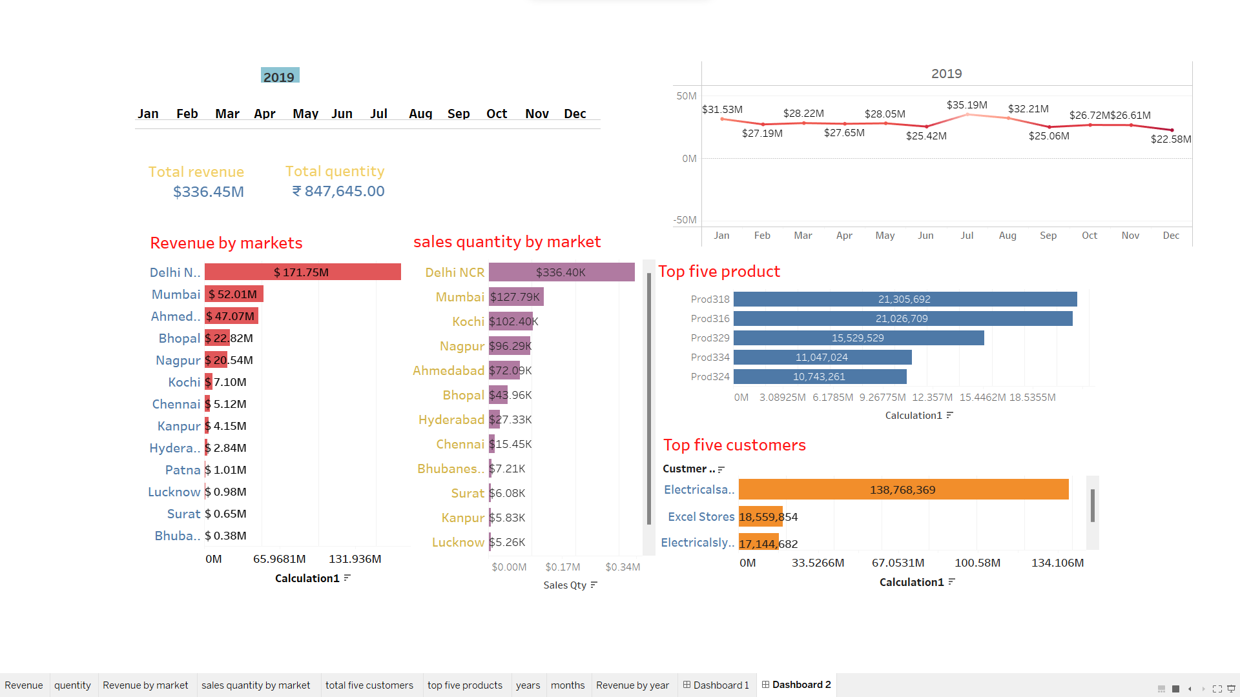
VISUALIZATION ON SALES INSIGHT BY 2019

Slide 15
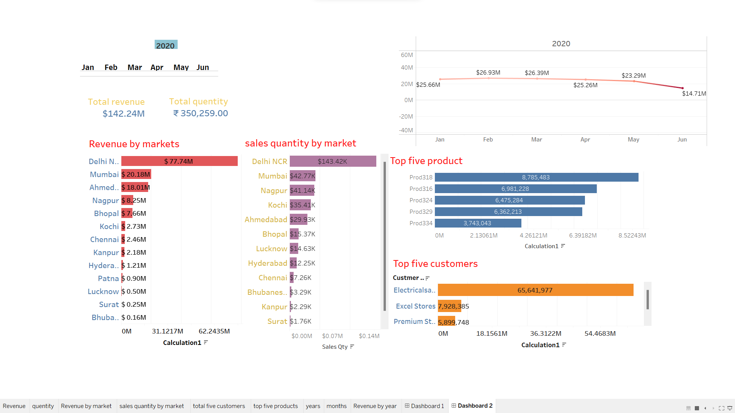
VISUALIZATION ON SALES INSIGHT BY 2020

Slide 16
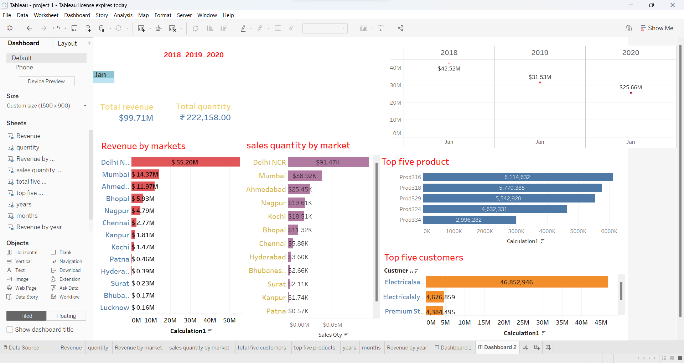
VISUALIZATION ON SALES INSIGHT BY JANUARY

Slide 17
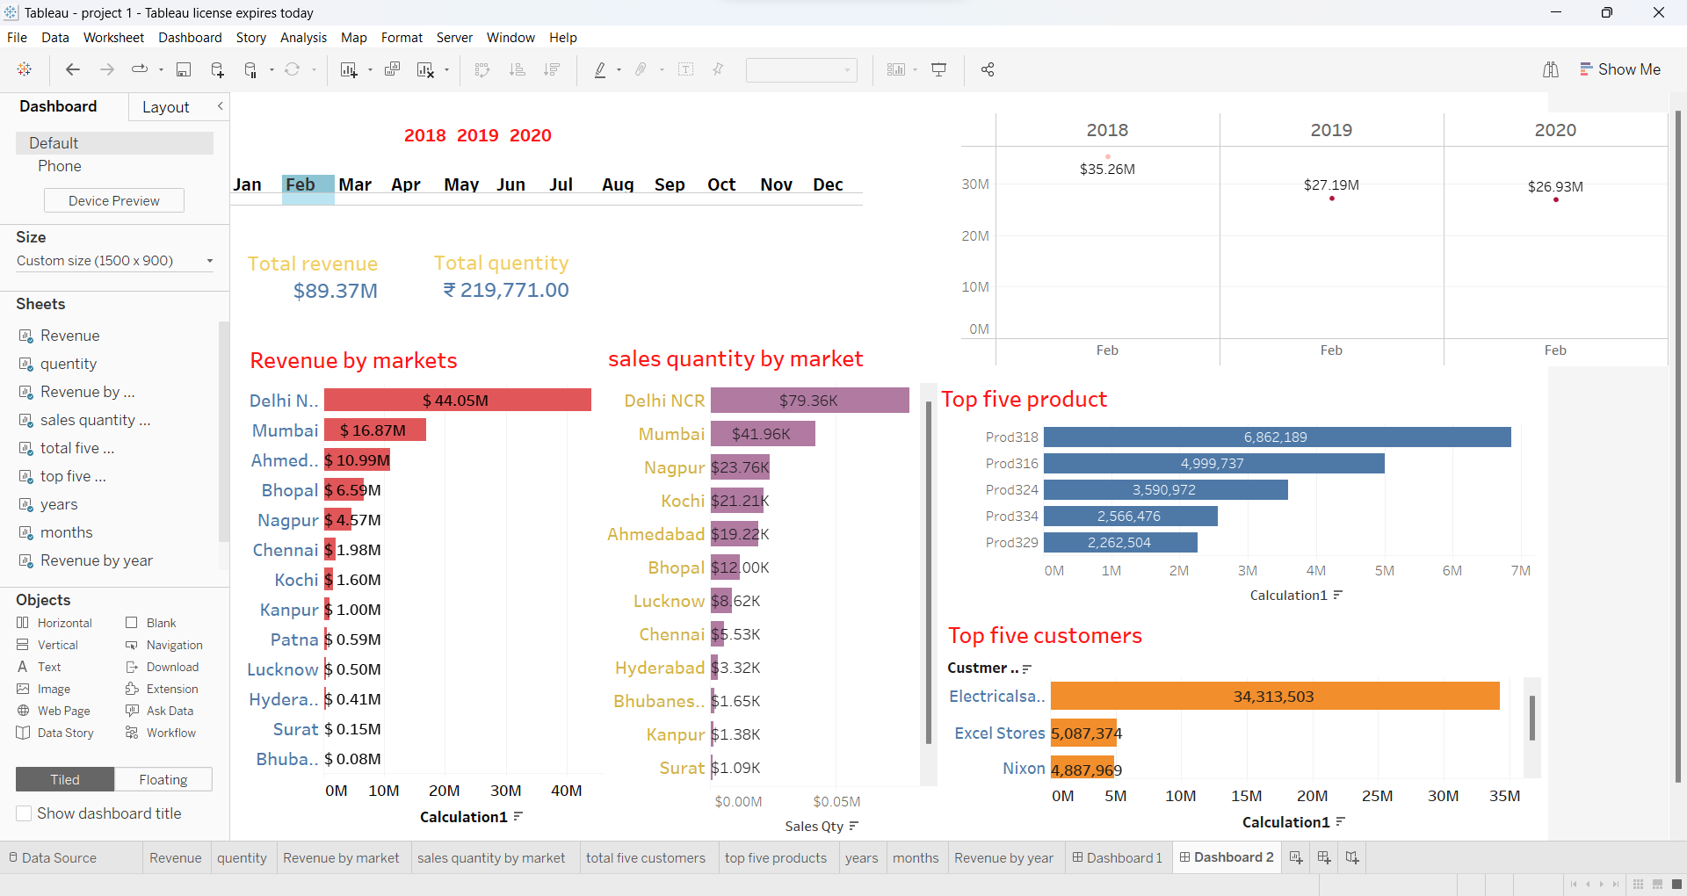
VISUALIZATION ON SALES INSIGHT BY FEBRUARY

Slide 18
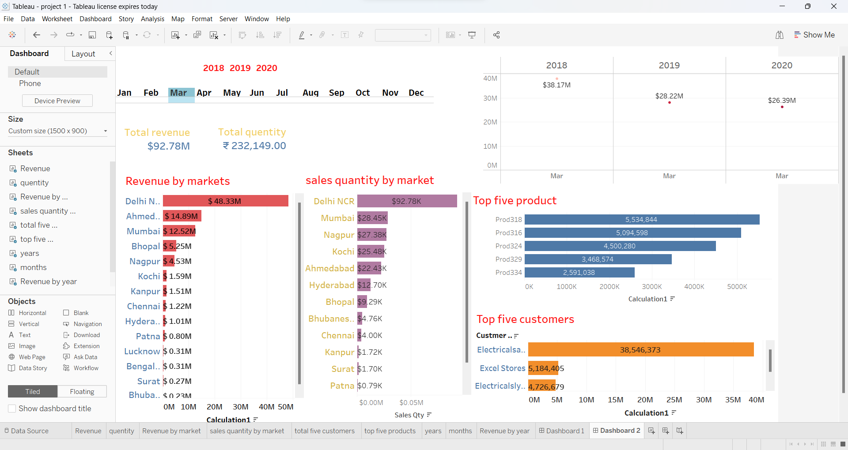
VISUALIZATION ON SALES INSIGHT BY MARCH

Slide 19
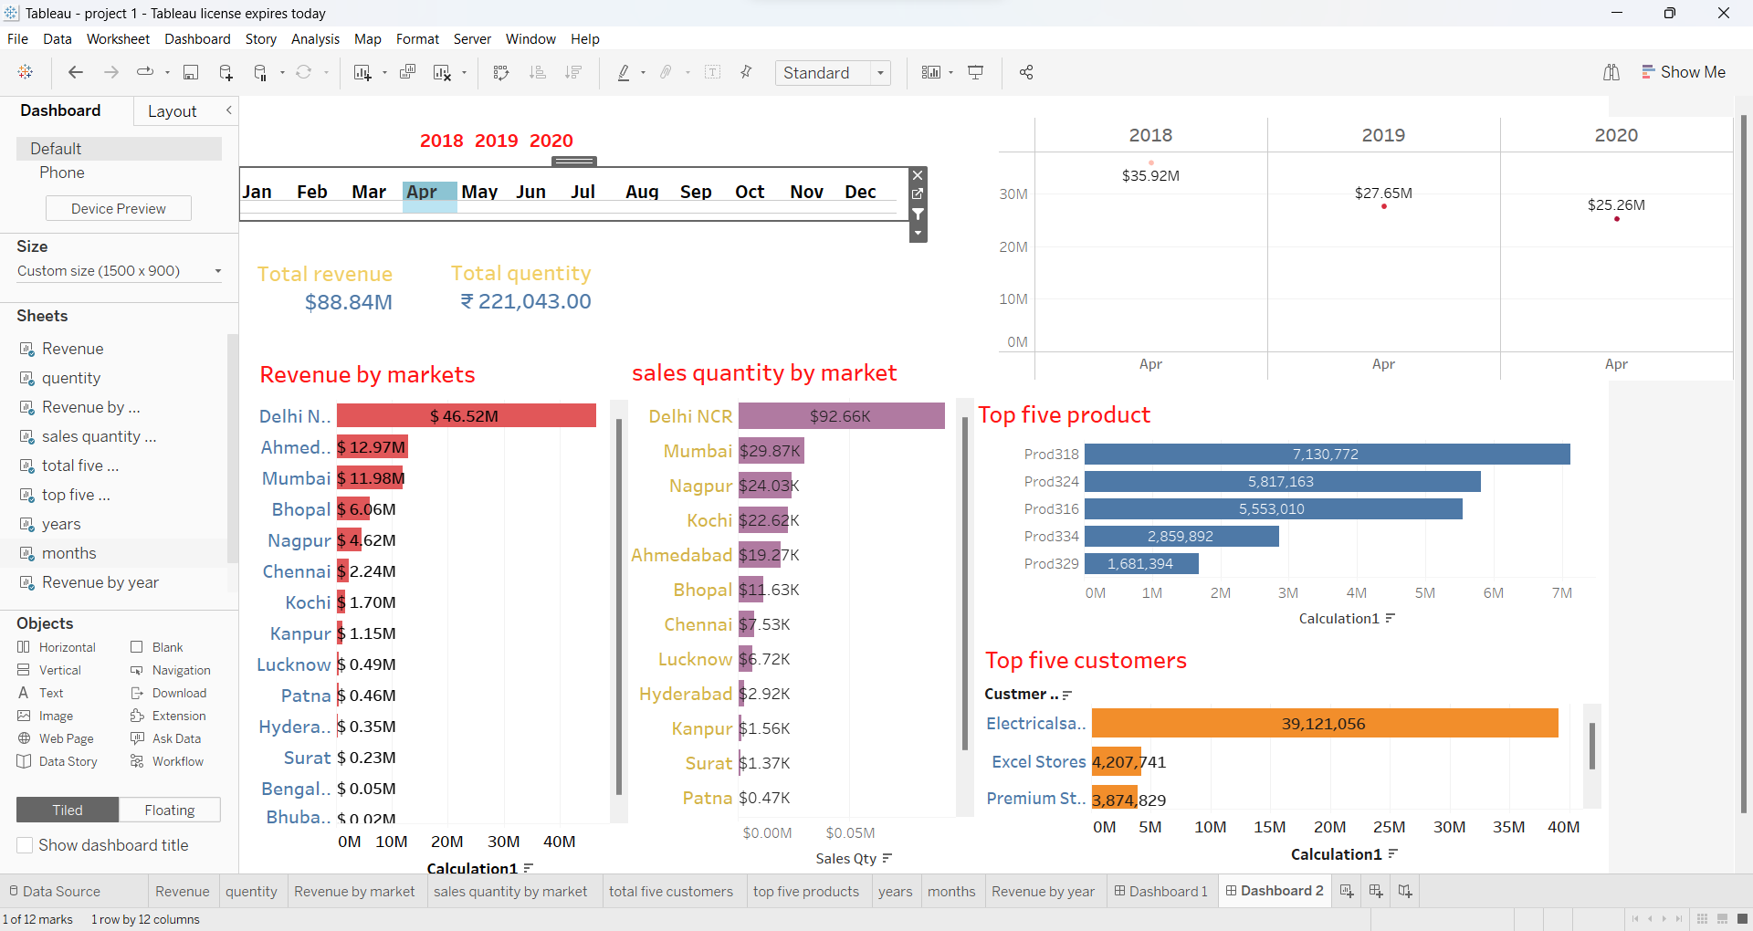
VISUALIZATION ON SALES INSIGHT BY APRIL

Slide 20
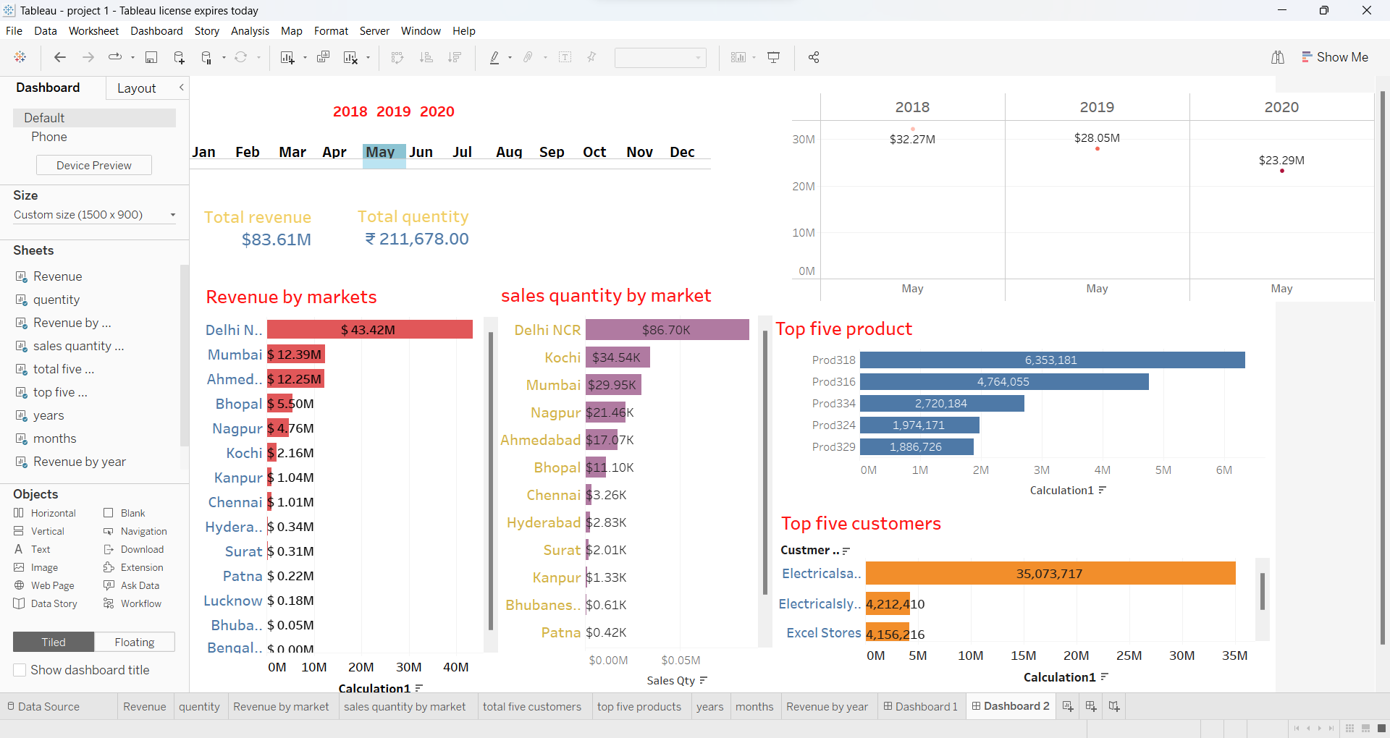
VISUALIZATION ON SALES INSIGHT BY MAY

Slide 21
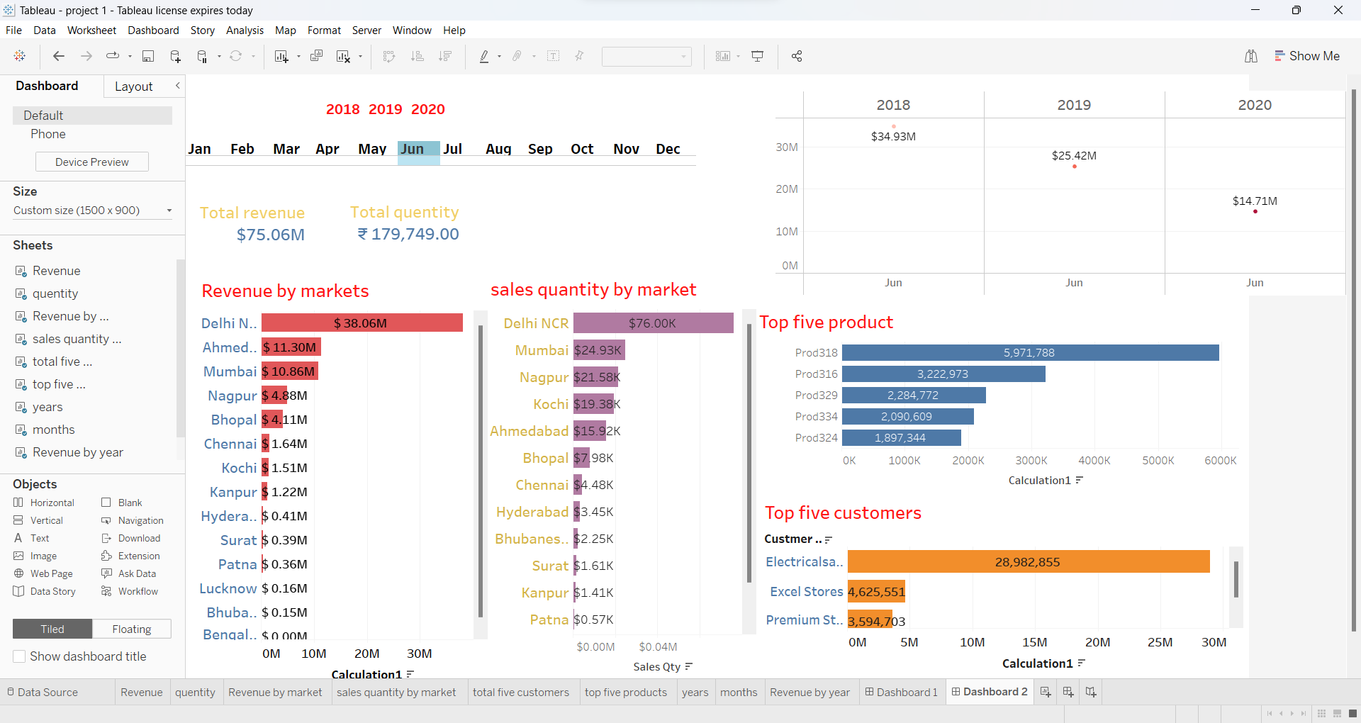
VISUALIZATION ON SALES INSIGHT BY JUNE

Slide 22
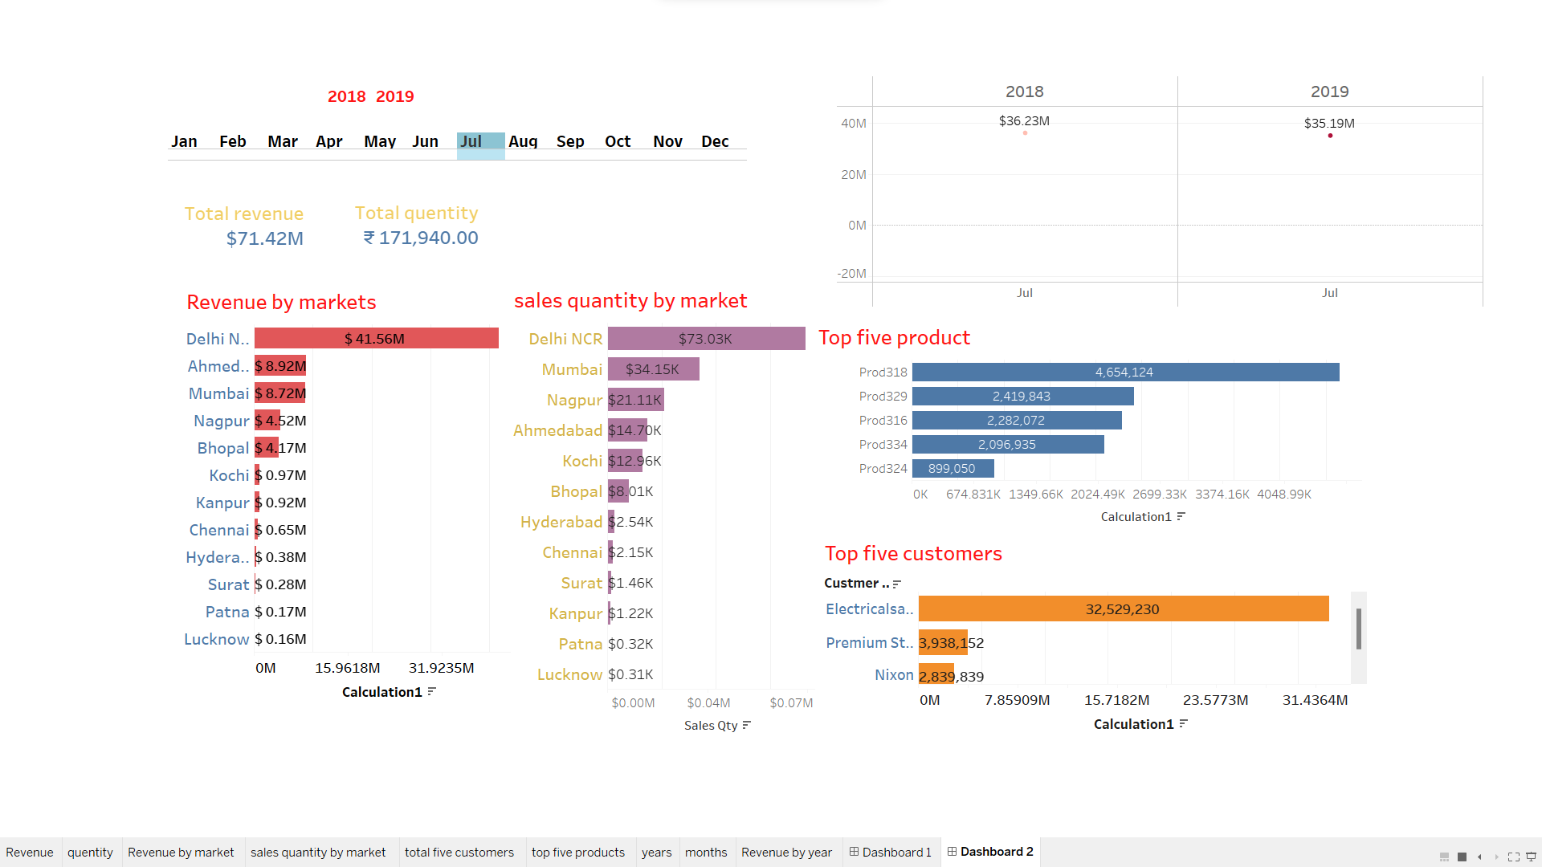
VISUALIZATION ON SALES INSIGHT BY JULY

Slide 23
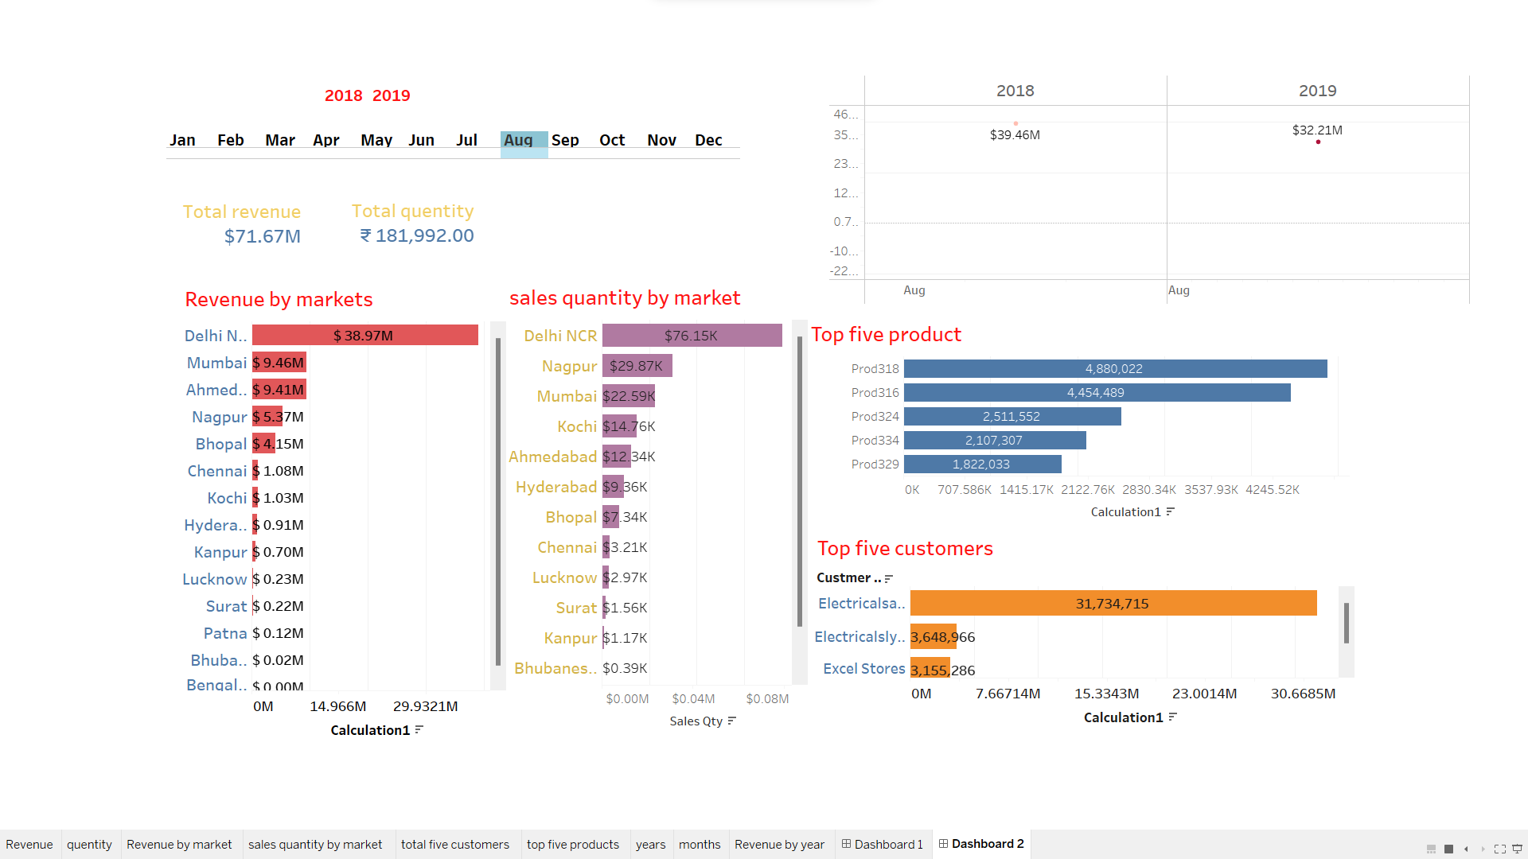
VISUALIZATION ON SALES INSIGHT BY AUGUST

Slide 24
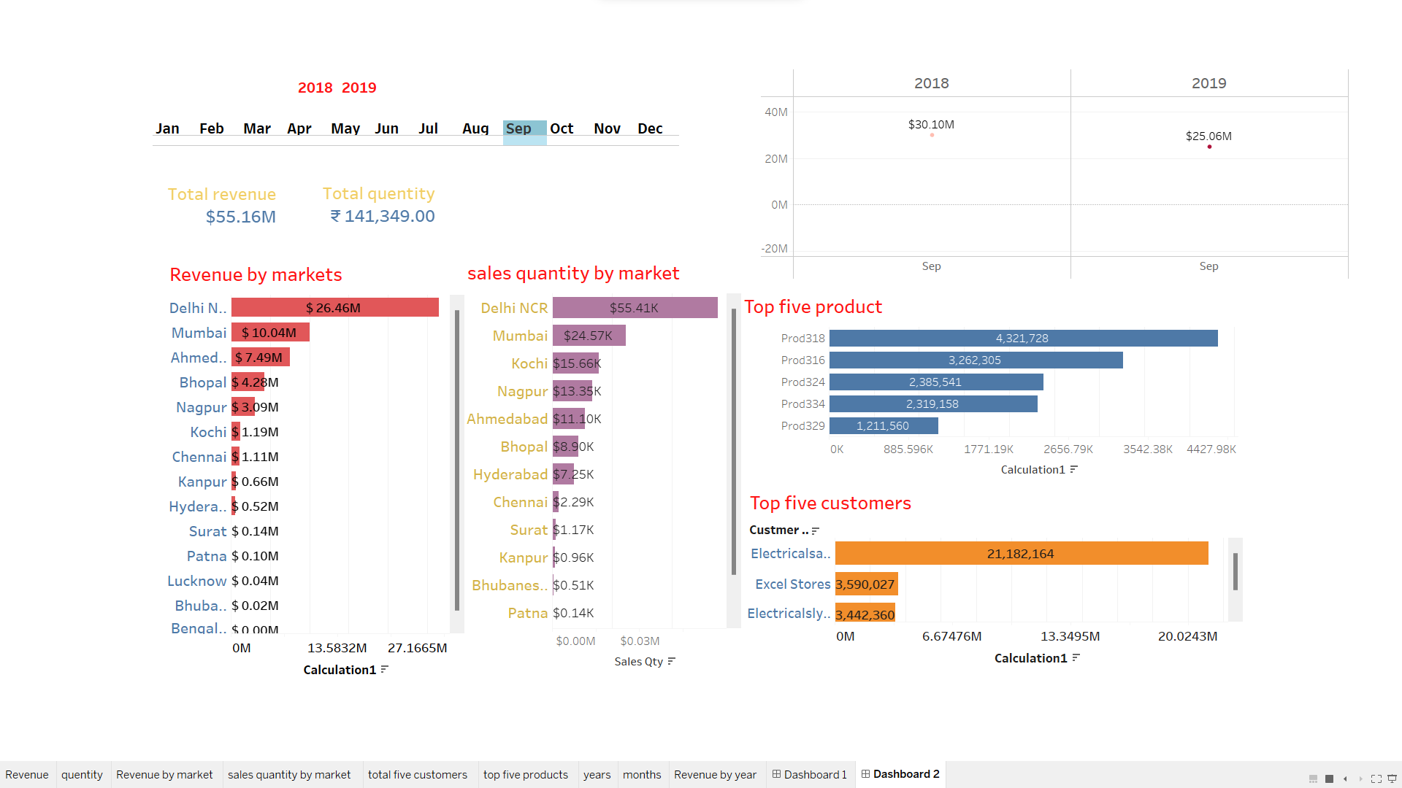
VISUALIZATION ON SALES INSIGHT BY SEPTEMBER

Slide 25
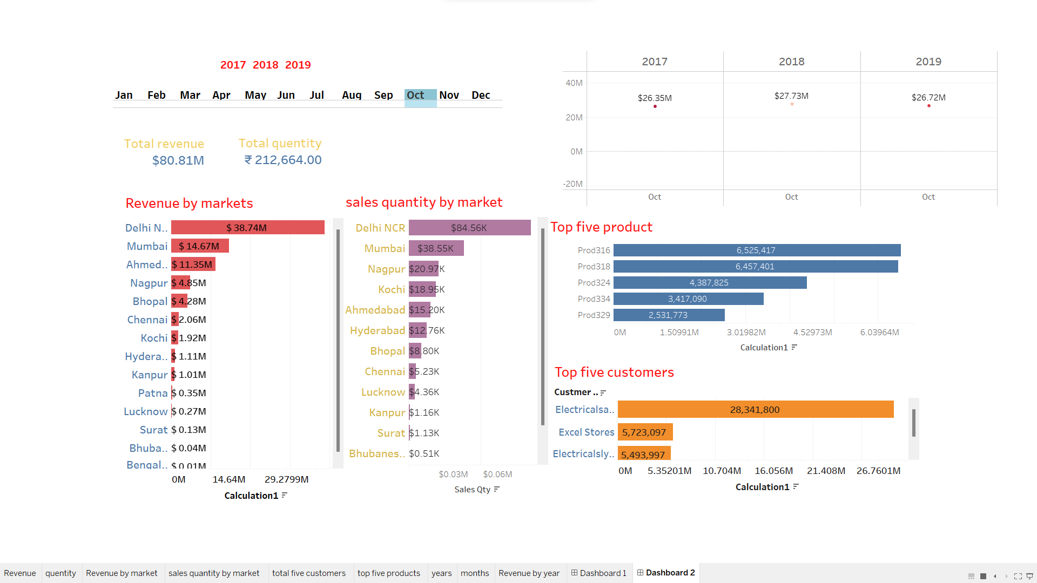
VISUALIZATION ON SALES INSIGHT BY OCTOBER

Slide 26

VISUALIZATION ON SALES INSIGHT BY NOVEMBER

Slide 27
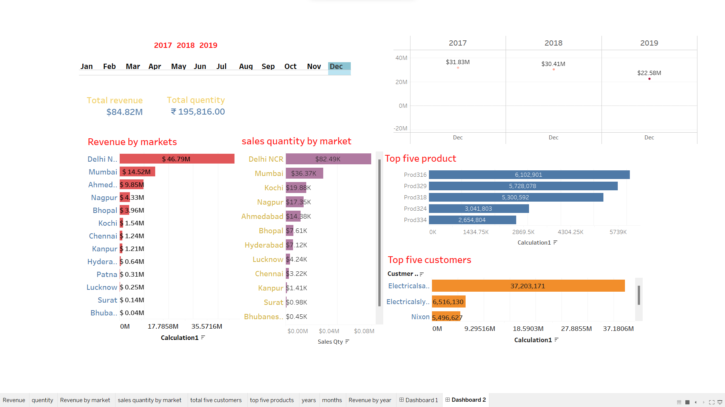
VISUALIZATION ON SALES INSIGHT BY DECEMBER

Slide 28
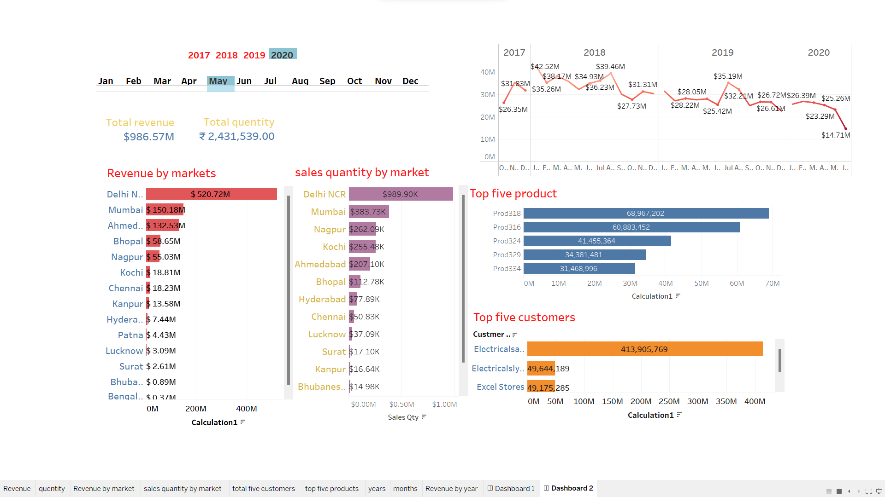
VISUALIZATION ON SALES INSIGHT BY ALL DATA

Slide 29
THE END Project 1
File created on: 29-01-2023 19:21:47

